Slide 1


Subject Code: SITA3005
Subject Name: Social Network Analysis
Faculty Name: Dr.L.Mary Gladence

Slide 2
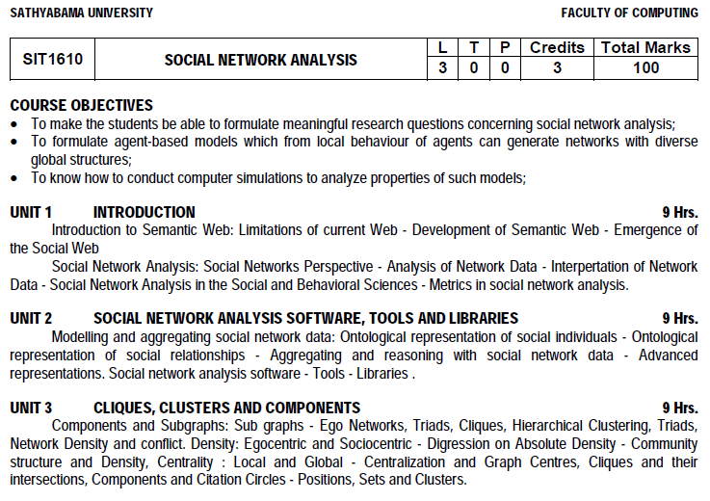
Syllabus

Slide 3
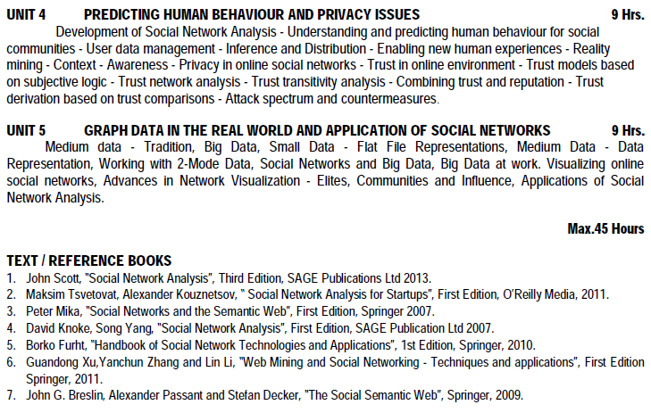
Syllabus

Slide 4
Syllabus
UNIT 1 INTRODUCTION 9 Hrs.
Introduction to Semantic Web: Limitations of current Web - Development of Semantic Web - Emergence of the Social Web
Social Network Analysis: Social Networks Perspective - Analysis of Network Data - Interpretation of Network Data - Social Network Analysis in the Social and Behavioral Sciences - Metrics in social network analysis.

Slide 5
Course Outcomes
On completion of the course, student will be able to:
CO1: Outline the importance of Social Network Analysis.
CO2: Classify the social network models
CO3: Describe cliques, clusters and components
CO4:Predict the human behavior of the different communities
CO5:Explain policies for privacy and trust
CO6:Visualize data using visualization tools..

Slide 6
Topics
Unit –I
Introduction -Semantic web
Purpose of Semantic web
History of web

Slide 7
Semantic web purpose
Humans are capable of using the web to carry out tasks such as finding the arabic word for “cat” searching low price on a DVD.
Computer cannot accomplish the same tasks without human direction because web pages are designed to be read by people, not machine.
The semantic web is a vision of information that is understandable by computers, so that they can perform more of the tedious work involved in finding, sharing and combining information on the web.

Slide 8
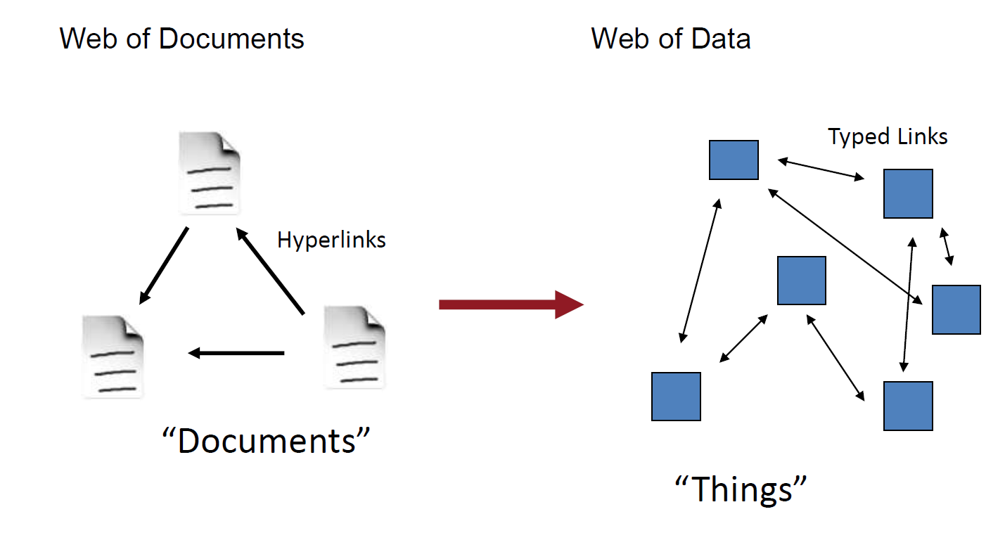
Semantic web
Semantic Web wants to transform the web from a "web of documents" into a "web of data".

Slide 9
motivation behind Semantic Web
Automation -handled by virtual assistants or agents.
Personalization - Agents can personalize or curate content for us
Information Retrieval - Semantic Web can give us more relevant answers
Data Reuse: - Semantic Web enables linking of data from a variety of sources
Knowledge Discovery: By linking data across the web, new knowledge can be discovered.

Slide 10
What is semantic web
Semantic = meaning
Semantic web = meaning +web
= web +data base technology+ knowledge Representation
Extension of the current web
A web where the focus is placed on the meaning of the words
A metadata based infrastructure
Semantic web is a group of methods and technologies to allow machines to understand the meaning – or “Semantics” –of information on the World Wide Web

Slide 11
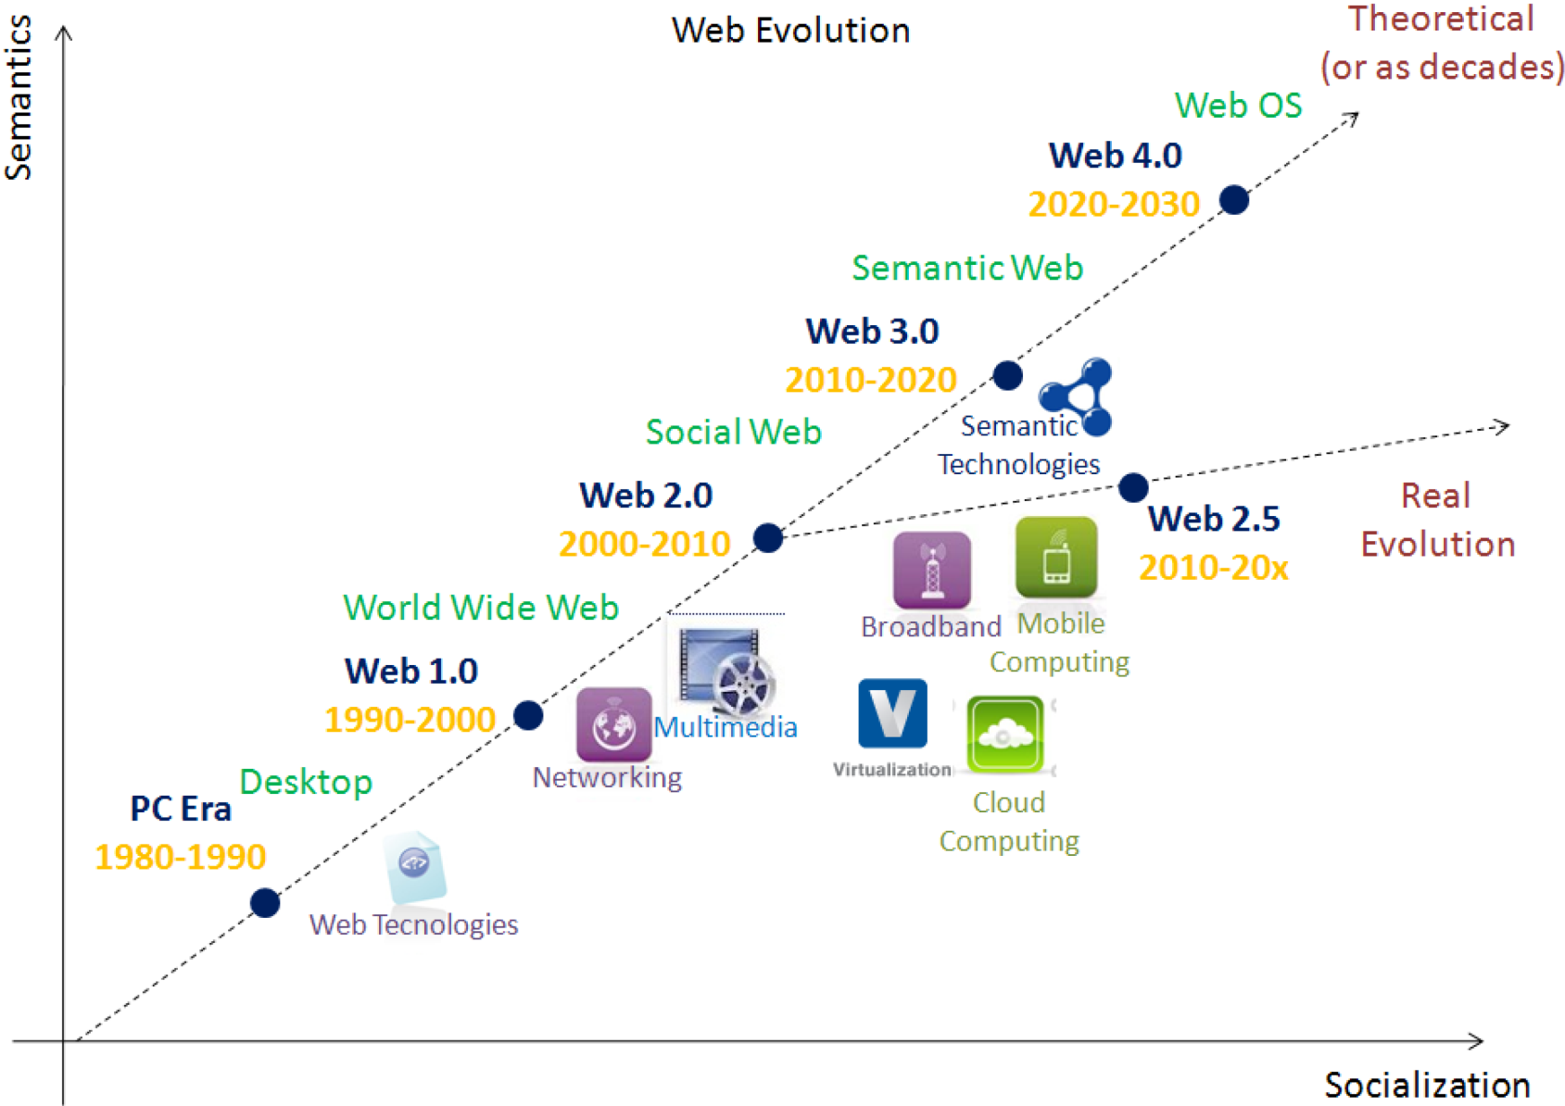
Brief History of Web

Slide 12
Brief History of Web
Web 1.0 (1990 – now)
Web browser driven
Started with handwritten HTML pages
Web 2.0 (2000 - now) : web of people and of participation, ie social web(Blogs, RSS, tgs, Facebook, Wikipedia etc)
Started with machine generated and HTML pages
Direct human processing (reading, browsing, form – filling)
Web of links
Web 3.0 (2010 - now): web of data, of meaning and connected knowledge, ie semantic web.

Slide 13
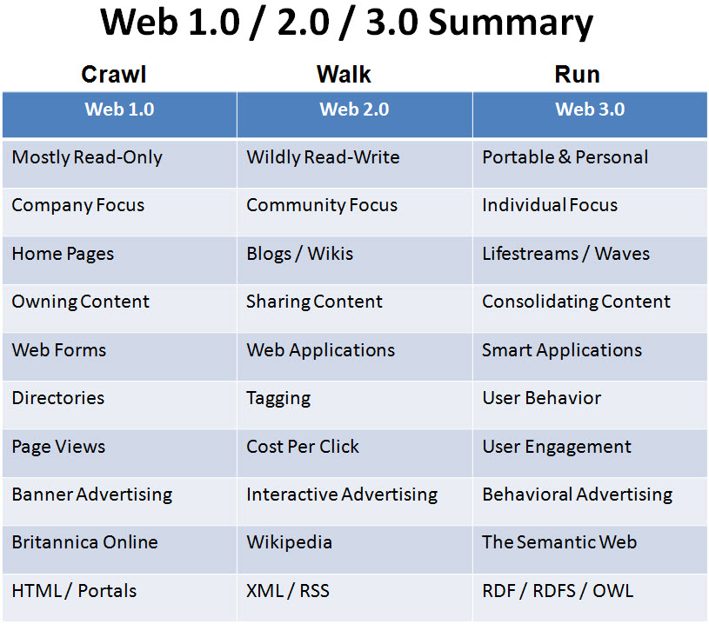

Slide 14
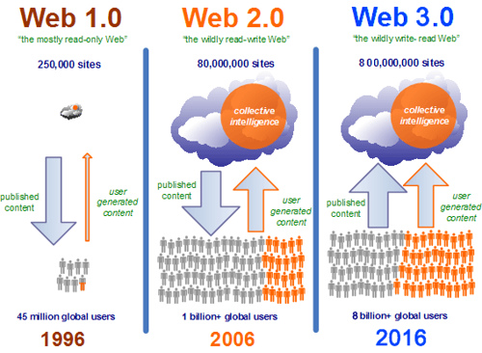
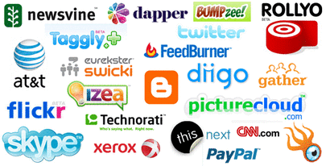

Slide 15
Need for semantic web
Today, we have problems in accessing and processing available information
Searching for information
Extracting information
Presenting information/maintenance
Automatic document generation
Sematic Web – Goal :
Share and Reuse data between applications, and communities

Slide 16
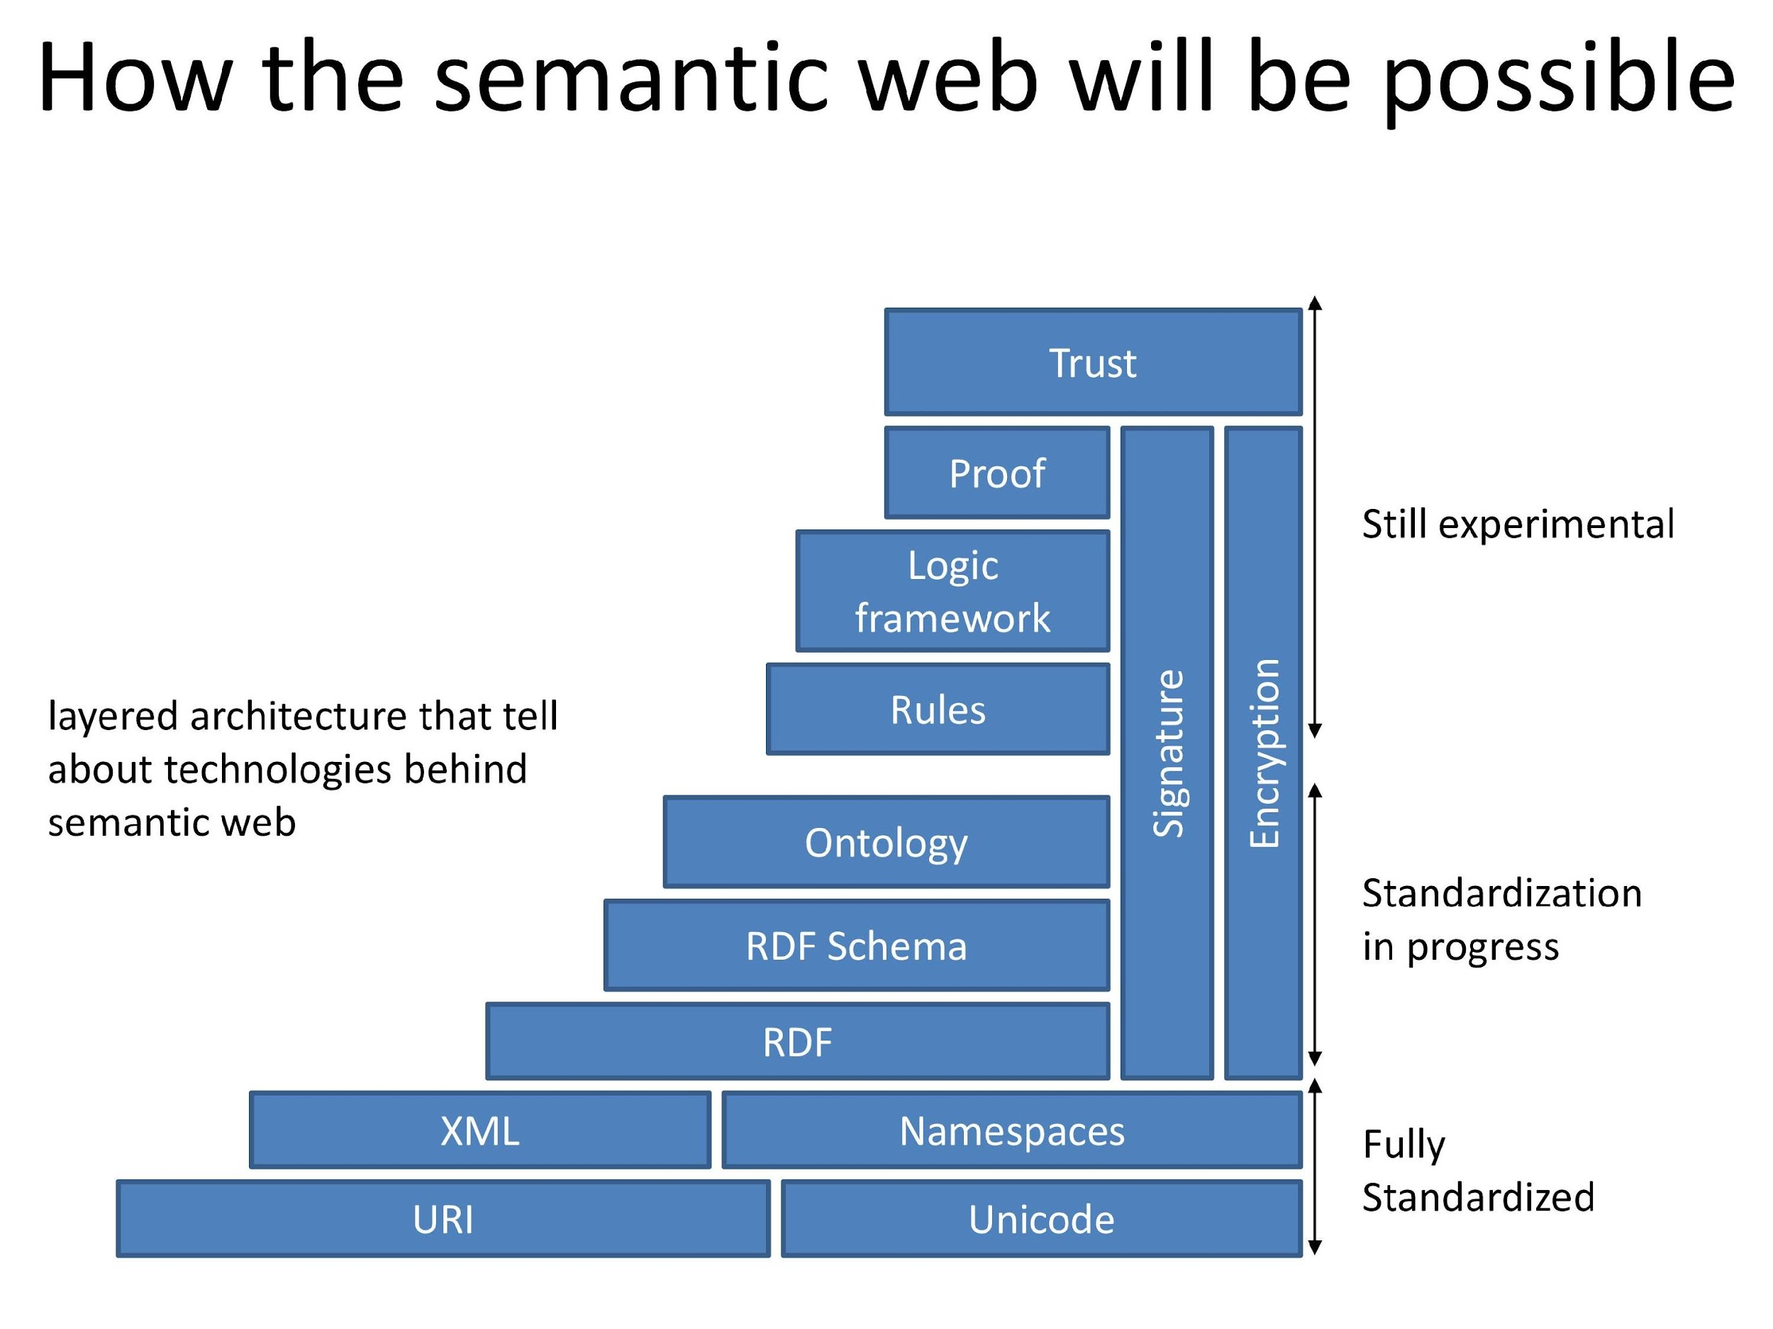

Slide 17
Components
Unicode
Standard for computer character representation
URI (uniform Resource Identifier)
A web identifer like strings starting with http or ftp
XML
Provide additional information about the text
Is content specific as opposed to presentation specific tags

Slide 18
Components
Resource Description Framework
A standard for web metadata developed by w3c
Suitable for describing web resources
Provides interoperability
Adds a simple data model on top of XML
Provides three elements: objects, properties, and value of properties

Slide 19
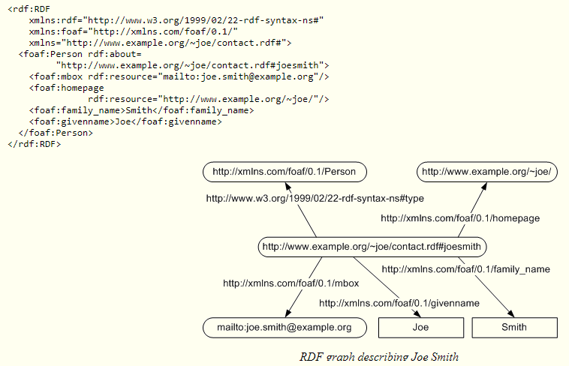
Resource Description Framework (format)

Slide 20
Components
RDF schema
Also known as RDF vocabulary Description Language
Definition of classes, inheritance hierarchies for classes and properties
Domain and range restrictions for properties
Ontology (Web Ontology Language : OWL)
Built on top of RDF
Have more vocabulary
OWL is for processing information on the web
Give the exact description of things and their relationship
Can make by ontology editors (Protégé, Ontolingua, Chamera)

Slide 21
Components
Logic and proof
An reasoning system provided on top of the ontology structure to make new inferences.
Using such a system, a software agent can make deductions as to whether a particular resource satisfies its requirements
Trust
Trustiness of web

Slide 22
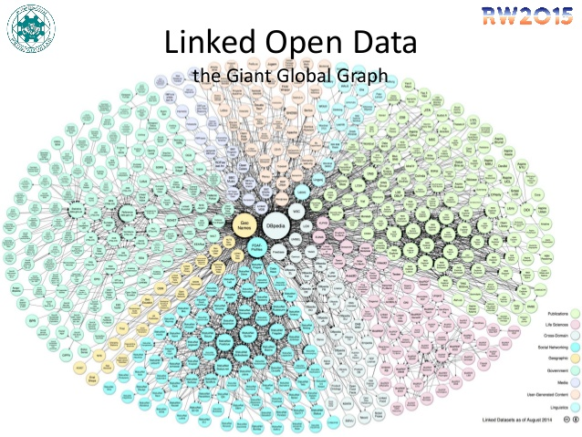
Features of Semantic Web
Semantic web related to
Web of data
Linked data (cloud)
Giant Global Graph
Web 3.0
Open Data
Big data
Allow machines to understand data
Ease sharing and mixing data
Extend WWW rather than replace it

Slide 23
Tools for information access
First Generation – keywords
Used in free text retrieval system
No ability to extract the meaning from the word or root stem
Not capable of understanding similar words
Ex “search” tool and “find” option in MS office
Second Generation – statistical forecasting
Calculate frequency and distance of keyword
Capable of understanding similar words
Can’t understand meaning of words or sentence
Ex . Tool is “Google”

Slide 24
Tools for information access
Third Generation – Natural Language Processing
Focus on the structure of language
Ex “man bites dog” is different from “dog bites man”
Fourth Generation – Semantic web architecture and applications
Automated conversion and storage of unstructured text sources in a semantic web database
Applications automatically extract and process the concepts and context in the database

Slide 25
Application area of semantic web
Knowledge management
B2C Web commerce
B2B electronic business
in 2007 that the oil and gas industry is using RDF/OWL to combine data from diverse sources
In April 2010, Facebook launched Open Graph that web publishers can use to integrate their web pages into Facebook's social graph
This enables Facebook to understand what a user likes, give personalized recommendations, or connect users with similar interests.
During the FIFA World Cup of 2010, BBC website used semantic web technologies to dynamically display content
Other examples include causality mining in pharma, semantic web mining, mining health records for insights, and fraud detection.

Slide 26
Key points of Semantic Web
The Semantic Web is the application of advanced knowledge technologies to the Web and distributed systems in general.
Information that is missing or hard to access for our machines can be made accessible using ontologies.
Ontologies are formal, which allows a computer to emulate human ways of reasoning with knowledge.
Ontologies carry a social commitment toward using a set of concepts and relationships in an agreed way.
The Semantic Web adds another layer on the Web architecture that requires agreements to ensure interoperability.

Slide 27
Limitations of The Current Web
The current Web has its limitations when it comes to:
finding relevant information
extracting relevant information
combining and reusing information
There is a unusual ability to adapt to the limitations of our information systems.
This means adaptation to our primary interface to the vast information that constitutes the Web: the search engine.

Slide 28
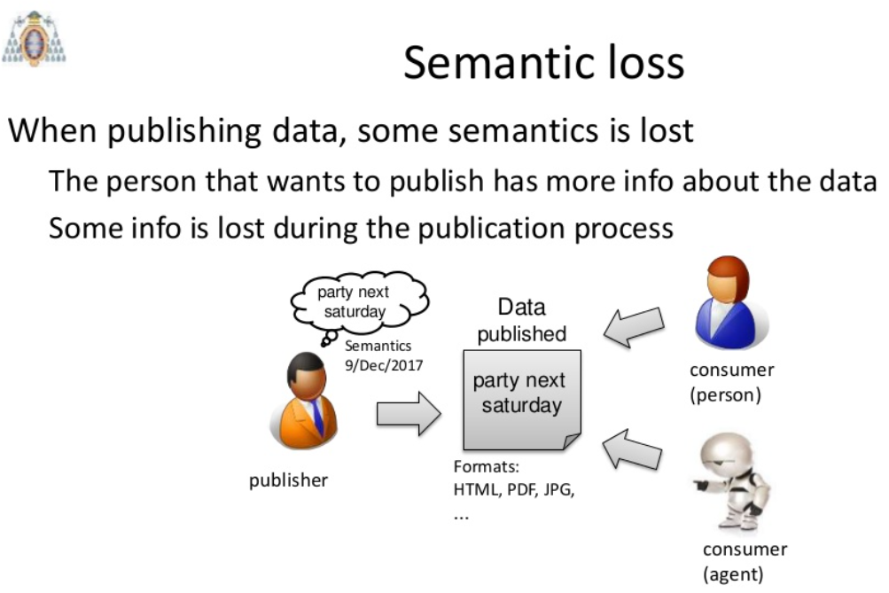

Slide 29
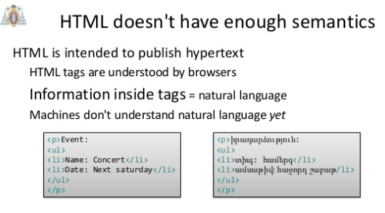

Slide 30
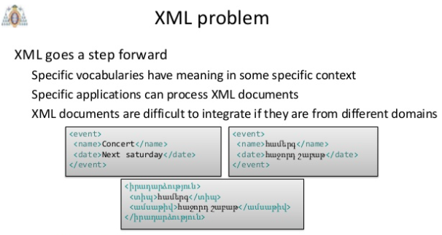

Slide 31
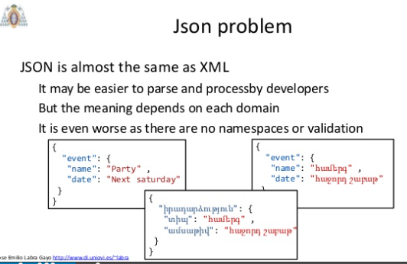

Slide 32
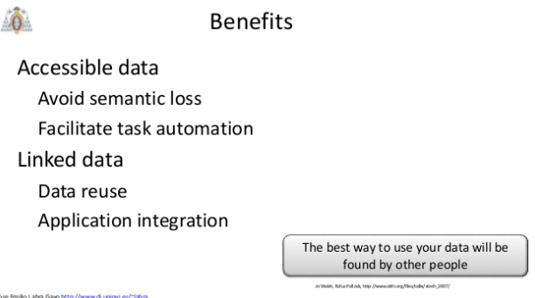
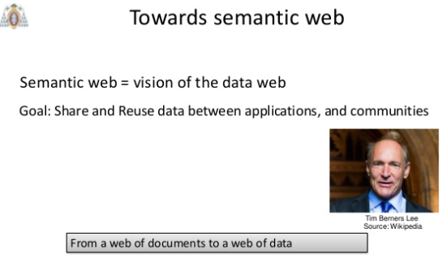
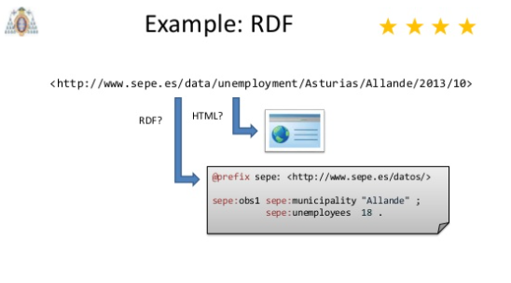
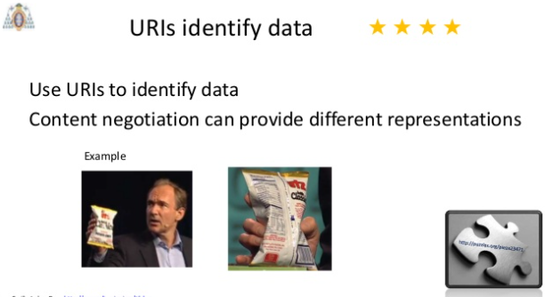

Slide 33
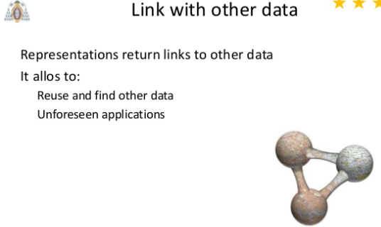
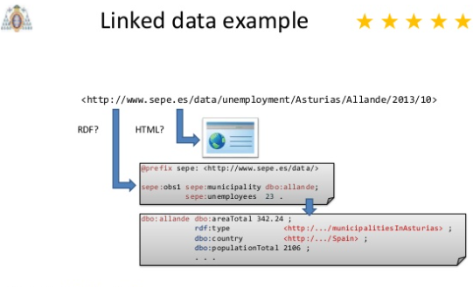
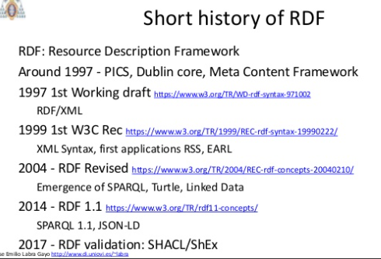
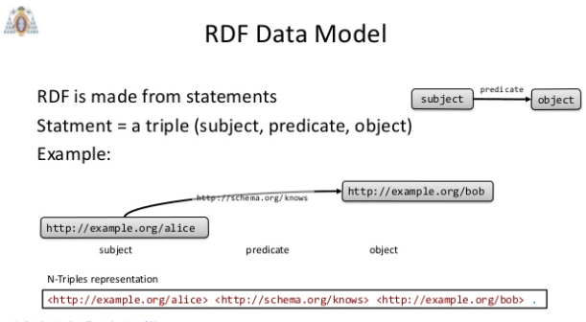

Slide 34
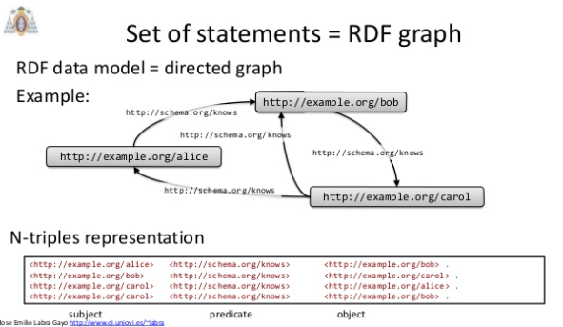

Slide 35
Limitations of The Current Web

Slide 36
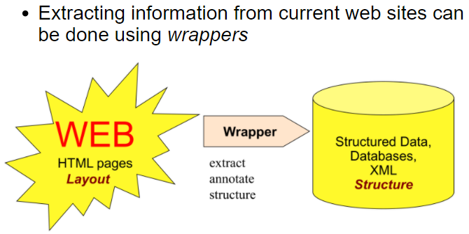
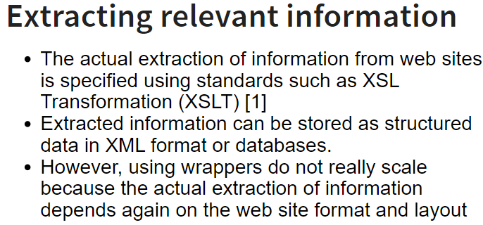
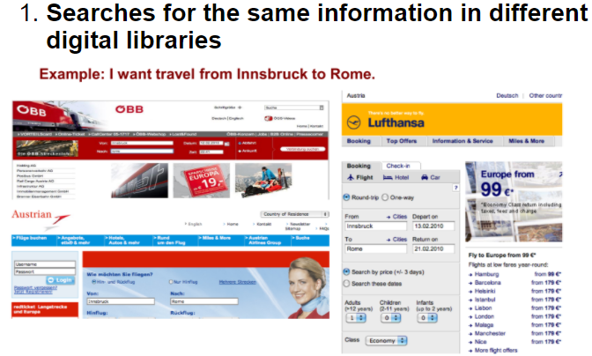
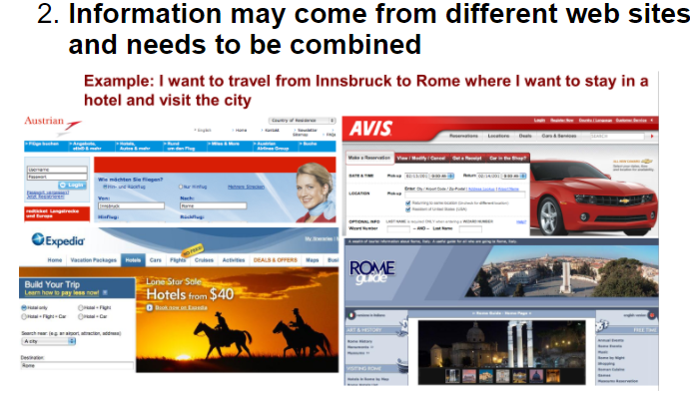

Slide 37
How to improve Current Web?
Increasing automatic linking among data
Increasing recall and precision in search
Increasing automation in data integration
Increasing automation in the service life cycle
Adding semantics to data and services is the solution!

Slide 38
Development of Semantic Web
The Semantic Web has been actively promoted by the World Wide Web Consortium. The organization is chiefly responsible for setting technical standards on the Web.
The key technological threads that are currently employed in the development of Semantic Web are:
eXtensible Markup Language (XML),
Resource Description Framework (RDF),
DAML (DARPA Agent Markup Language).

Slide 39
Social Web
The social web is a set of social relations that link people through the World Wide Web.
Websites and software are designed and developed in order to support and foster social interaction
Online shopping education, gaming and social networking
The term "social Web" was coined by Howard Rheingold

Slide 40
Network Analysis
The social aspect of Web 2.0 communication has been to facilitate interaction between people with similar tastes.
These tastes vary depending on who the target audience is, and what they are looking for.
For individuals working in the public relation department, the job is consistently changing and the impact is coming from the social web.
The influence, held by the social network is large and ever changing.

